Slide 1
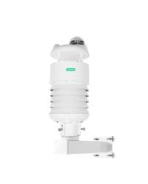
Forecasting Daily Air Temperature in Doho, Uganda Using Machine Learning and Deep Learning
Accurate Temperature Predictions for Agriculture, Energy, and Disaster Preparedness BY GROUP 6

Slide 2
Problem Statement & Justification
Problem:
Predict daily air temperature using historical weather data (2013–2016) in Doho, Uganda.
Accurate forecasts help farmers, energy providers, disaster management authorities, and urban planners.
Justification:
Weather data is sequential → temporal models like LSTM capture trends.
Feature engineering (lags, rolling stats, date-based features) improves model performance.
Supports data-driven decisions in agriculture, energy, and disaster preparedness.

Slide 3
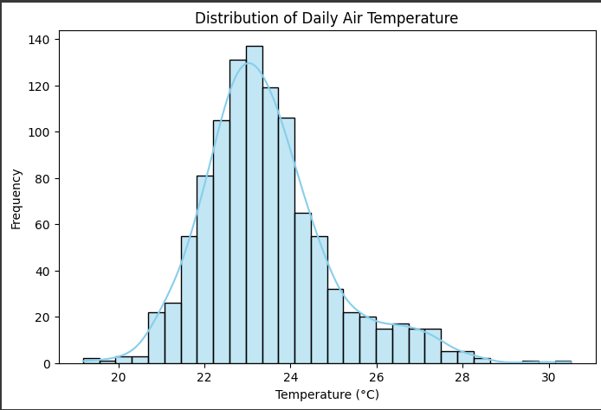
Data & Feature Engineering
Feature Engineering:
Lag variables: 1,2,3,7,14 days
Rolling statistics: 7-day mean & std
Date features: Month, Day-of-Year, Weekday
One-hot encoded station identifiers
Dataset:
Daily observations from multiple stations (Temperature, Humidity, Min/Max Temp, Station ID).

Slide 4
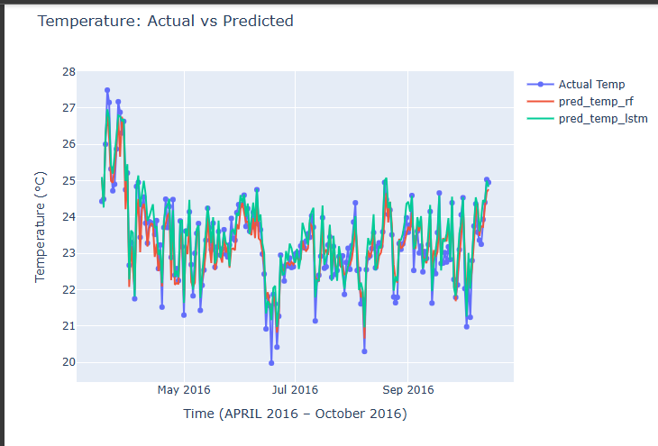
Modeling Approach & Metrics
Models Used:
Random Forest Regressor (RF) – classical ML
LSTM – deep learning for sequential data
Evaluation Metrics:
Metric | Purpose
MSE | Penalizes large errors
MAE | Average absolute error
RMSE | Same units as temperature
R² | Variance explained

Slide 5
Key Results & Interpretations
Observations:
LSTM outperforms RF across all metrics.
Captures temporal dependencies better → smoother, accurate forecasts.
Residuals centered around 0 → unbiased predictions.
Model Performance:
Model | MSE | MAE | RMSE | R²
Random Forest | 0.176 | 0.332 | 0.419 | 0.872
LSTM | 0.139 | 0.301 | 0.374 | 0.898

Slide 6
Recommendations & Future Work
Recommendations for Stakeholders:
Farmers: Optimize irrigation, planting, harvesting.
Energy Providers: Plan load demand & infrastructure maintenance.
Disaster Management: Early warnings for heat/cold events.
Urban Planners & Policy Makers: Climate adaptation, urban heat planning.
Future Additions:
Include rainfall, wind speed, and humidity predictions.
Multi-station spatial modeling (Graph Neural Networks).
Ensemble modeling & real-time forecasts with dashboards/APIs.
Climate trend analysis for long-term planning.

Slide 7
PROJECT SUMMARY
The dataset available at https://dataverse.harvard.edu/dataset.xhtml?persistentId=doi:10.7910/DVN/UTVRUD
Project title
Problem statement and justification
Data description and derived features
Data cleaning
Data exploration and visualization (statistics, univariate, bivariate and multivariate analysis)
Modeling and evaluation
Models used are random forest Regressor and long short term memory and their metrics (LSTM)
Feature importance graph for random forest
Temperature actual vs predicted graph
Prediction error & anomaly detection graph
Residual error distribution graph
Metrics overview (MSE,MAE,RMSE, R²)
Recommendations
future work

